Slide 1
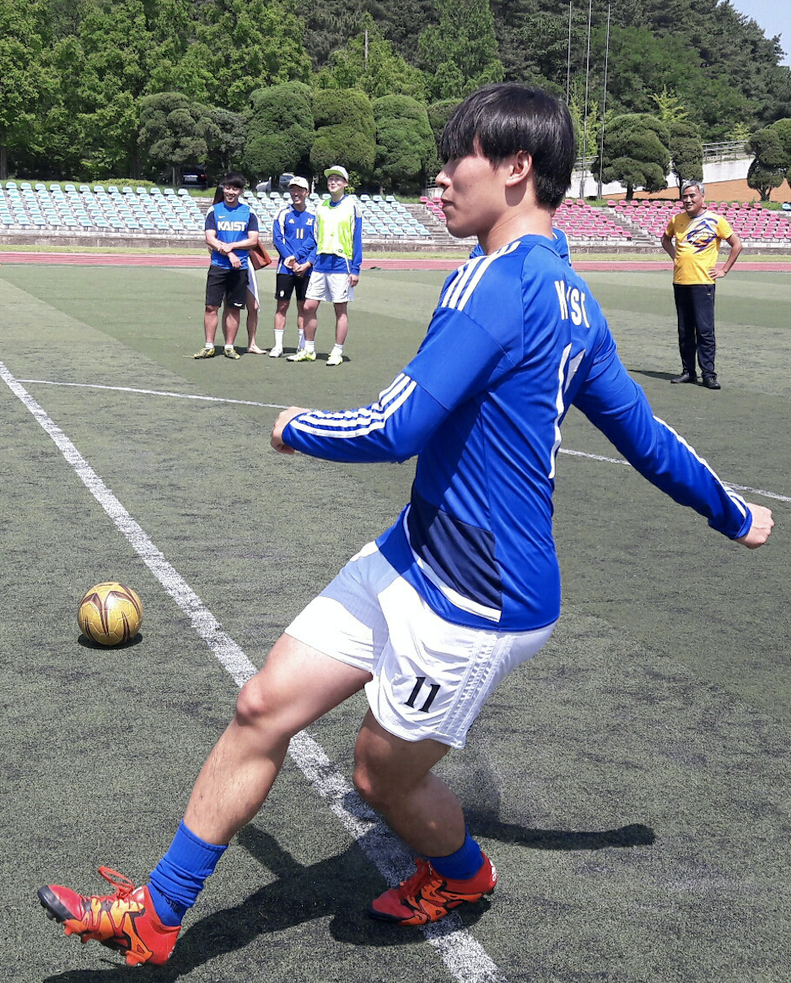
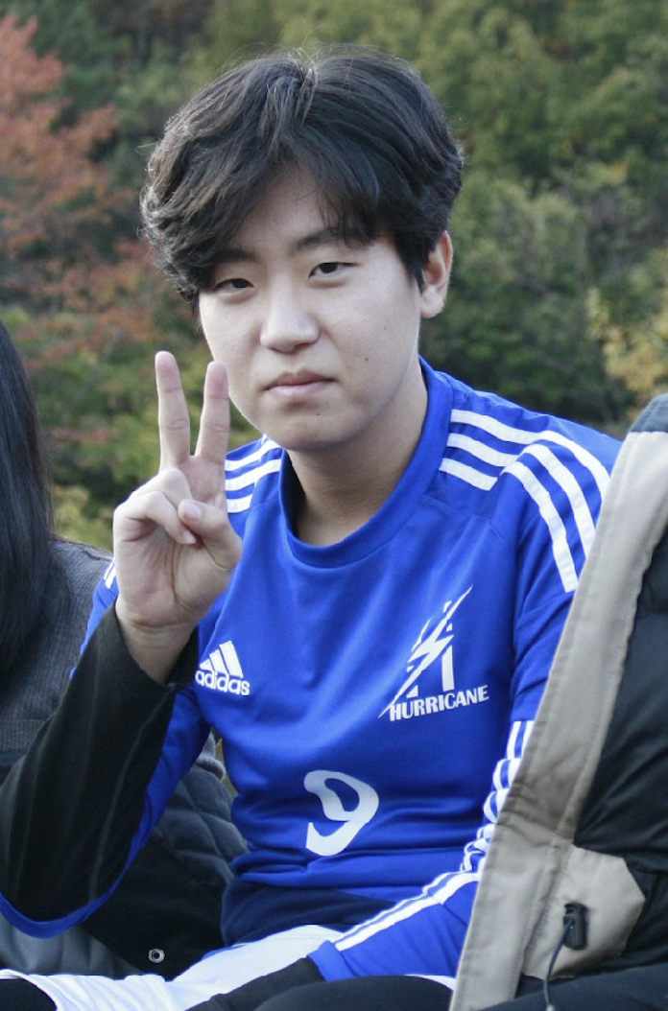
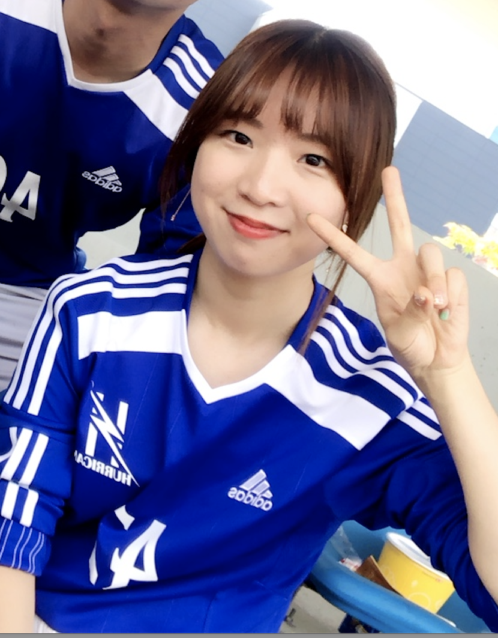
P4T
PPT for Team
CS408(F) Computer Science Project
Team Hurricane
⭐️ LEADER ⭐️
Hyunsu Hyungrok Yuna
Notes:
Good afternoon, everyone.
Wecome to CS408 team hurricane’s project pitch.
My name is Hyunsu, This is Hyungrok, and Yuna.
Our project title is P4T, which stands for PPT for team.
Before we start, I want to do a quick survey.
Throughout your campus life (could be present or past), if you had any major or minor difficulties working on team projects, would you please raise your hand?
wow~ almost everyone!

Slide 2

Team Project
P4T : PPT for Team
Team Hurricane
Notes:
As we have just seen, most students, including us here, experience some difficulties working as a team.
To find out what actual difficulties there are..

Slide 3



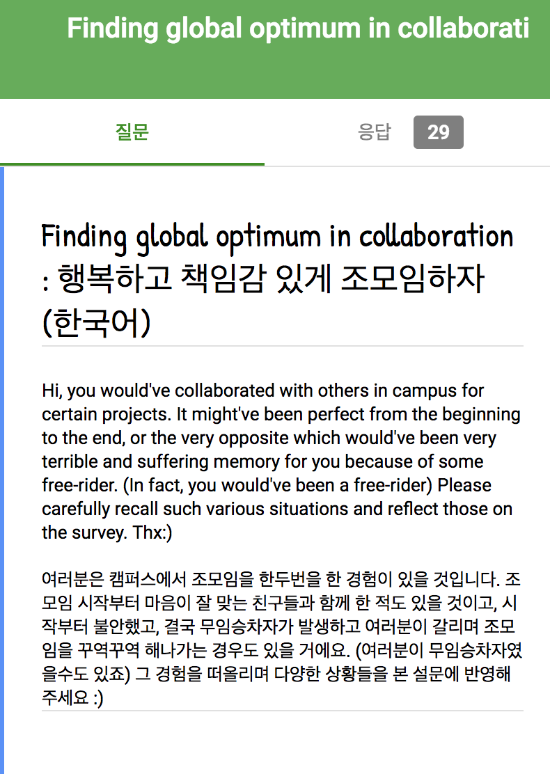
User Study
P4T : PPT for Team
Team Hurricane
Notes:
we conducted user study.
We interviewed about 20 students and also distributed an online survey then got replies from 29 students.

Slide 4
Problems
P4T : PPT for Team
Team Hurricane
Choosing time & place is difficult
Gathering is bothersome
Not equally participating (Freerider)
Coordinating opinions is hard
etc.
Notes:
And these were common problems that students were suffering.
(pause)
The most common issue was that setting time and place that every members are available is too difficult.

Slide 5

Problems
P4T : PPT for Team
Team Hurricane
Choosing time & place is difficult
Gathering is bothersome
Notes:
Then we chose two main problems to tackle:
First is what I’ve just mentioned,
and Second gathering is bothersome.
Let me put it this way:
Even after your team sets the meeting time,
once the time comes,
it’s highly likely that you’d rather want to stay in your dorm wearing pajamas than going out.
We thought these problems mainly originates from the fact that each team actually need to gather physically.
Therefore,

Slide 6
Solution
P4T : PPT for Team
Team Hurricane
Help members to gather online as if offline
to do team project efficiently
without physical meeting
Notes:
We came up with solution and let me introduce briefly:
여기까진 ppt 언급 ㄴㄴ
근데 팀 프로젝트에는 코딩, 보고서, 발표 등 형태가 많다.
(한 번 읽ㄱ어주구)
Up to here, you may think the team project is too broad. It could be coding, writing reports, or giving presentations not making people yarn.

Slide 7
Solution
P4T : PPT for Team
Team Hurricane
Help members to gather online as if offline
to make slides together efficiently
without physical meeting
Notes:
우리는 그중에 slide에 집중하기로했다. 왜냐면 대부분의 조모임은 발표니까!
Among these, we chose on making slides for presentation. It’s because most team projects include midterm- or final- presentations like CS408.

Slide 8
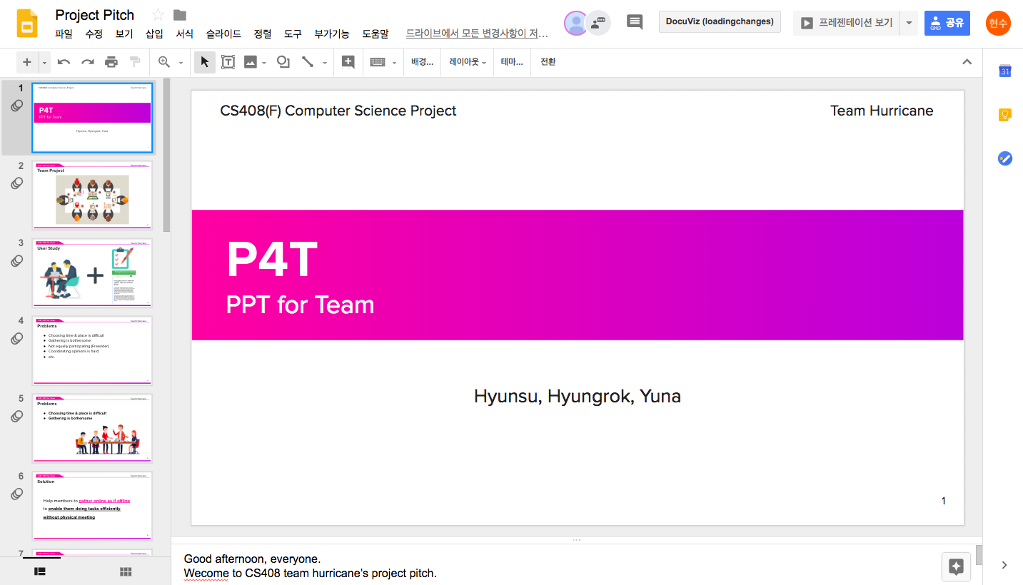

Existing Solution?!
P4T : PPT for Team
Team Hurricane
Notes:
This is existing solutions.. google slides!
I know, with GoogleSlides you can do almost everything, however
there are still existing problems like:
when your team tries to make slides together without gathering,
아마 다들 우리 설명을 들으면서 구글 슬라이드를 떠올렸을 거다
근데 원격으로 구글 슬라이드를 통해 조모임을 해보면, 문제가 많다! 만나지 않아서 생기는 문제들

Slide 9
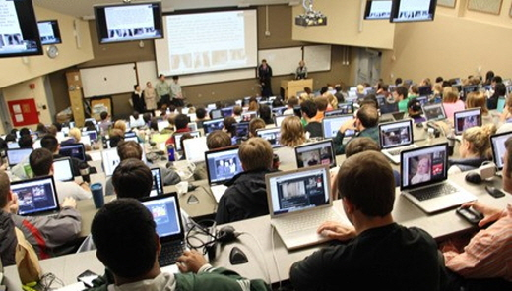
Problem: Google Slides
P4T : PPT for Team
Team Hurricane
Notes:
It’s hard to check if every members are doing their job properly. One may watch YouTube
GoogleSlides를 실제 여러 조모임에서 사용 -> 여전히 불편
의사소통하기 힘들다 -> 카톡 왕래 불편
켜놓기만 하고 아무것도 안하고 딴짓한 사람들

Slide 10


Problem: Google Slides
P4T : PPT for Team
Team Hurricane
Notes:
GoogleSlides를 실제 여러 조모임에서 사용 -> 여전히 불편
의사소통하기 힘들다 -> 카톡 왕래 불편
켜놓기만 하고 아무것도 안하고 딴짓한 사람들

Slide 11
Solution: P4T
P4T : PPT for Team
Team Hurricane
[+] Voice chat
[+] Contribution level
Notes:
그래서 우리는! 직접 만나서 함께 하는 것 같은 platform을 만들거다
In detail, we would facilitate voice chat so that they could lively interact in one platform.
포인트: 갑자기 감시한다 그래서 좀 어색함. 딴짓하는걸 좀 강조했으면 좋을듯
오프라인과 온라인의 차이점
Also, we’ll inform others ~. I know that this may sound freaky and too much, however in order to guarantee that your team is actually gathering while it’s offline, we thought this is worthy.

Slide 12
Gather Online as if Offline with P4T
P4T : PPT for Team
Team Hurricane
Notes:
So this is the end of our pitch!
Thank you and any Questions?

Slide 13
APPENDIX
P4T : PPT for Team
Team Hurricane

Slide 14
Problems: Analysis
P4T : PPT for Team
Team Hurricane
CSCW
Computer Supported Cooperative Work
Github, Google Docs etc..

Slide 15
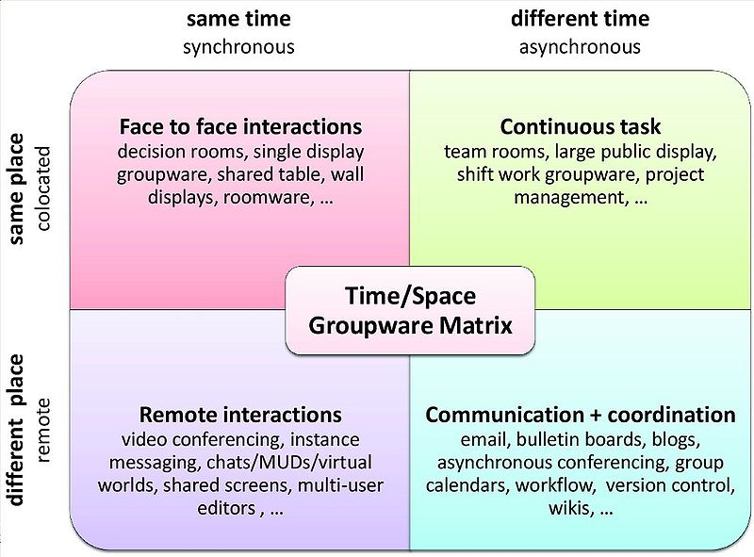
Problem: Analysis
P4T : PPT for Team
Team Hurricane
Notes:
컴퓨터 협업하는 툴을 총칭하여 CSCW라고 한다. 여기에는 time, space dimension이 있다. 현재 구글 docs는 협업 툴로서 different time, different place이다. 우리는 조모임의 이러한 문제점이 differenent time different place에서 발생하는 것으로 본다.

Slide 16
Problem: Analysis
P4T : PPT for Team
Team Hurricane
Notes:
컴퓨터 협업하는 툴을 총칭하여 CSCW라고 한다. 여기에는 time, space dimension이 있다. 현재 구글 docs는 협업 툴로서 different time, different place이다. 우리는 조모임의 이러한 문제점이 differenent time different place에서 발생하는 것으로 본다.

Slide 17
Problems
P4T : PPT for Team
Team Hurricane
Choosing time & place is difficult
Gathering is bothersome
Not equally participating (Freerider)
Coordinating opinions is hard
etc.

Slide 18
Problems
P4T : PPT for Team
Team Hurricane
Choosing time & place is difficult
Gathering is bothersome
Not equally participating (Freerider)
Coordinating opinions is hard
etc.

Slide 19
Problems
P4T : PPT for Team
Team Hurricane
Gathering is bothersome
Choosing time & place to meet is difficult
Not equally participating (Freerider)
Coordinating opinions is hard
etc.

Slide 20
Additional Function : contribution level
P4T : PPT for Team
Team Hurricane
Show each member’s contribution level (#)
to encourage participation of freeriders
Notes:
showing contribution level

Slide 21
Additional Function : contribution level
P4T : PPT for Team
Team Hurricane
from accomplished tasks (ToDo List)
from number of slides that he/she made

Slide 22
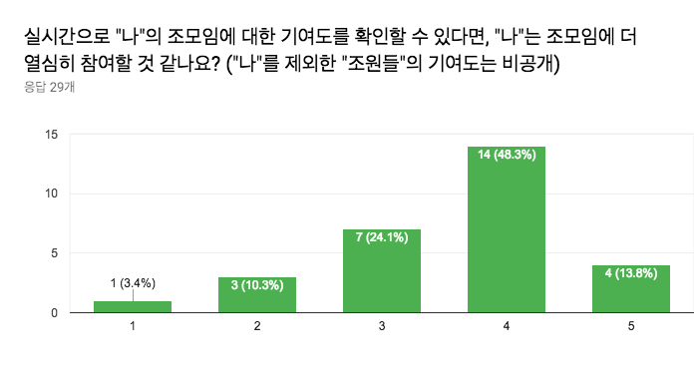
Additional Function : contribution level
P4T : PPT for Team
Team Hurricane
Notes:
실제로 설문조사를 통해 확인해본 결과 이런 기능이 있으면 더 ㅇ려심히 참여할 것 같다고했음

Slide 23
Team Hurricane
P4T : PPT for Team
Team Hurricane
Hyunsu Hyungrok Yuna
⭐️ LEADER ⭐️
Notes:
Good afternoon, everyone.
Wecome to CS408 team hurricane’s project pitch.
My name is Hyunsu, This is Hyungrok, and Yuna.
Our project title is P4T, which stands for PPT for team.
Before we start, I want to do a quick survey.
Throughout your campus life (could be present or past), if you had any major or minor difficulties working on team projects, would you please raise your hand?
wow~ almost everyone!

